Slide 1

UI Solution For Semantic Analysis
Intelligent agent Arnav Snakhe

Slide 2
Table Of Content
Introduction
Project Analysis
Data Pre-processing
Modeling Algorithms
Gradio Interface
Results
Challenge
Future Works

Slide 3
Introduction
Semantic analysis is the study to identify people’s emotions in the written text like a review of a product, service or tweet.
Sentiment analysis became very popular in early 2000s as product reviews and tweets exploded on the internet.
Hence three algorithms Linear SVC, Xgboost, Random Forest were used to create models.

Slide 4
Project Analysis

Slide 5
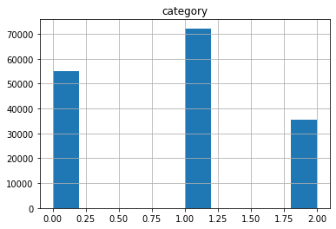
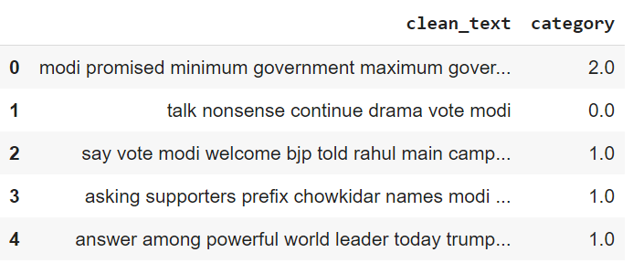
Data Pre-Processing
Dataset.
Missing values.
Data Normalization
Data Cleaning using Regular expressing
TF-IDF feature matrix

Slide 6
Modeling Algorithms
Linear SVC
XGBoost
Random Forest

Slide 7
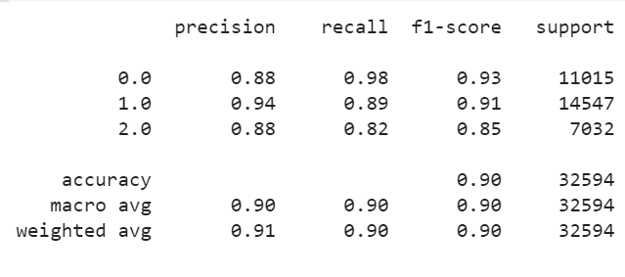
Linear SVC
High Accuracy
High Precision
High Recall
High average F1 score of 90%

Slide 8
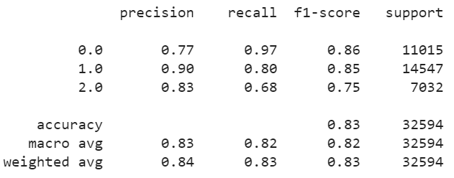
XGBoost
Good Accuracy.
High Recall.
Low Precision.
Good average F1 score of 82%.

Slide 9
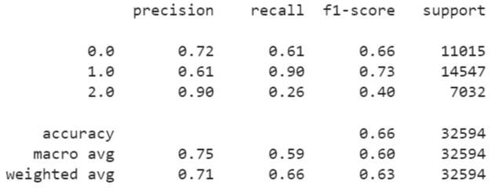
Random Forest
Low accuracy
Low Precision
Low Recall
Low average F1 score of 60%.

Slide 10
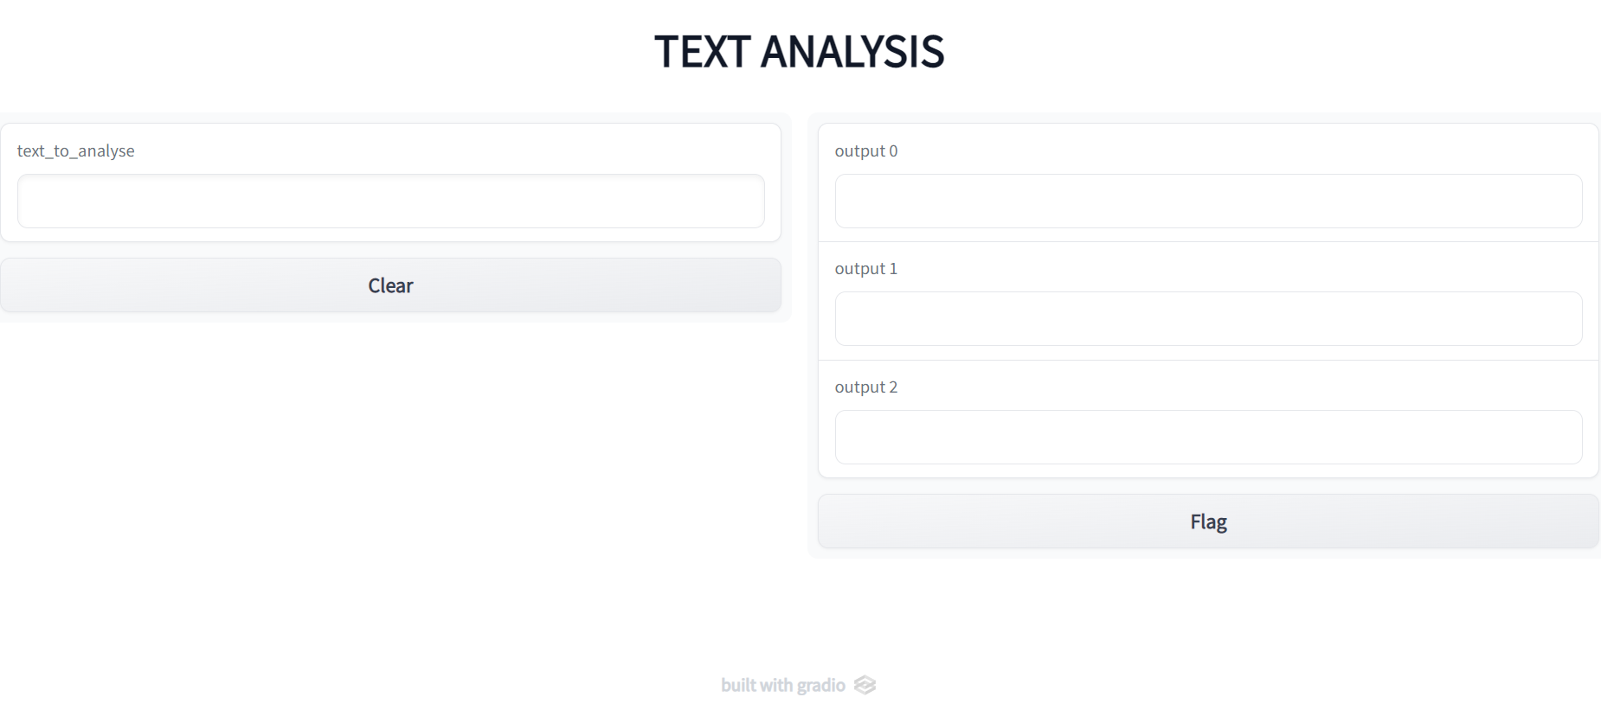
Gradio Interface

Slide 11
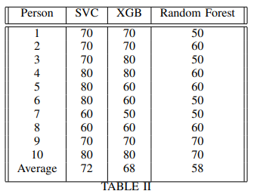
Results
Human trials
Linear SVC performed the best in live testing.

Slide 12
Challenge
The major challenge was to understand that you cannot update the model with new training data or correct mis classifications using tf-idf vectorizer.
The reason being if Tfidf Vectorizer gets new features (vocabulary words) which will then change the shape of the feature vector (no. of columns will increase), which leads to input shape mis match error even with partial_fit(). Hence you have to retrain whole model.
HashingVectorizer.
HashingVectorizer seemed to be a good alternative as it will not change the feature size on the new data and hence can be used with partial_fit on any estimator.
It failed to produce any results.

Slide 13
Future works
For improving the performance and functionality

Slide 14
Future works
Machine learning is only suitable for constant data.
If retraining is need to update the agent with new data, deep learning is the way to go. RNN could be used for NLP tasks.
Performance can be further improved by perfectly tuning hyperparameters, training more ml algorithms to have a detailed comparison and see which works best for the given dataset .
Another thing could be implemented is to have ensemble method approach which will greatly improve the collective accuracy of the output which could maybe beat the deep learning approach.

Slide 15
Thank you

